Slide 1
Data Recovery
Mitchell Dawson Chris Forgie
Jon Davis Steve Tauber
CSSE 592/492 Computer Forensics
www.SeminarsTopics.com

Slide 2
Overview
What is Data Recovery?
How can it be used?
Techniques
  Recovery Methods
  Secure Deletion
  Private vs. Government services
  Software vs. Hardware Solutions
What can you do?

Slide 3
What is data recovery?
Retrieving deleted/inaccessible data from electronic storage media (hard drives, removable media, optical devices, etc...)
Typical causes of loss include:
  Electro-mechanical Failure
  Natural Disaster
  Computer Virus
  Data Corruption
  Computer Crime
  Human Error
Example
  http://www.drivesavers.com/museum/qtpopisdn.html

Slide 4
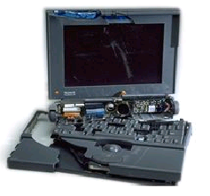
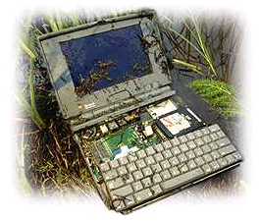
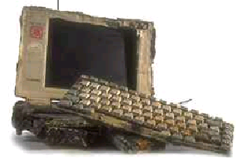
Cases of Recovery
FIRE
Found after a fire destroyed a 100 year old home – All data Recovered
CRUSHED
A bus runs over a laptop – All data recovered
SOAKED
PowerBook trapped underwater for two days – All data recovered

Slide 5
Uses of data recovery
Average User:
  Recover important lost files
  Keep your private information private
Law enforcement:
  Locate illegal data
  Restore deleted/overwritten information.
  Prosecute criminals based on discovered data

Slide 6
Software Recovery of data
Generally only restore data not yet overwritten.
Do not work on physically damaged drives
Undelete Pro, EasyRecovery, Proliant, Novanet, etc.
Prices range from Free-1000
Example: dd on linux used on corrupt floppies

Slide 7
Private Recovery Services
Many private companies offer quick, secure, and confidential data recovery:
  Computer Disk Service http://www.compdisk.com
    20 GB from $195.00
    46 GB and up – from $895.00
  Action Front http://www.datarec.com/
    External cases - $500 to $1500
    Internal cases -$2500 to $4000 for a single hard drive
    Critical Response services start at $5,000.
  Data Recovery Services - http://www.datarecovery.net/

Slide 8
Recovery Methods
Hidden files
Recycle bin
Unerase wizards
Assorted commercial programs
Ferrofluid
  Coat surface of disk
  Check with optical microscope
  Does not work for more recent hard drives
More recently…

Slide 9
Recovery Methods
When data is written – the head sets the polarity of most, but not all, of the magnetic domains
The actual effect of overwriting a bit is closer to obtaining a 0.95 when a zero is overwritten by a one, and a 1.05 when a one is overwritten with a one.
  Normal equipment will read both these values as ones
  However, using specialized equipment, it is possible to work out what the previous “layers” contained
Steps include
  Reading the signal from the analog head electronic with a high-quality digital oscilloscope
  Downloading the sampled waveform to a PC
  Analyzing it in software to recover the previously recorded signal.

Slide 10
Recovery Methods
Scanning Probe Microscopy (SPM)
  Uses a sharp magnetic tip attached to a flexible cantilever placed close to the surface to be analyzed, where it interacts with the stray field emanating from the sample to produce a topographic view of the surface
  Reasonably capable SPM can be built for about US$1400, using a PC as a controller
  Thousands in use today

Slide 11
Recovery Methods
Magnetic force microscopy (MFM)
  Recent technique for imaging magnetization patterns with high resolution and minimal sample preparation.
  Derived from scanning probe microscopy (SPM)
  Uses a sharp magnetic tip attached to a flexible cantilever placed close to the surface to be analyzed where it interacts with the stray magnetic field
  An image of the field at the surface is formed by moving the tip across the surface and measuring the force (or force gradient) as a function of position. The strength of the interaction is measured by monitoring the position of the cantilever using an optical interferometer.

Slide 12
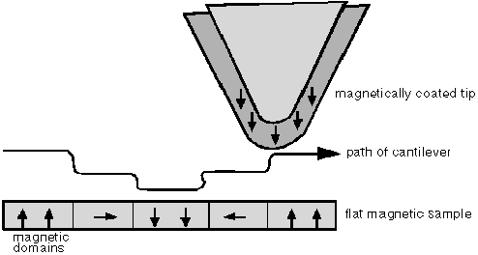
Recovery Methods
Magnetic force microscopy (MFM)

Slide 13
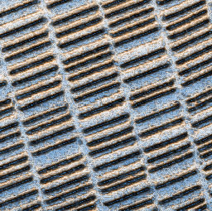

Slide 14
Recovery Methods
Using MFM:
  Techniques can detect data by looking at the minute sampling region to distinctly detect the remnant magnetization at the track edges.
  Detectable old data will still be present beside the new data on the track which is usually ignored
  In conjunction with software, MFM can be calibrated to see past various kinds of data loss/removal. Can also do automated data recovery.
  It turns out that each track contains an image of everything ever written to it, but that the contribution from each "layer" gets progressively smaller the further back it was made.

Slide 15
How to Avoid Data Recovery
Companies, agencies, or individuals may want to ensure their data cannot be recovered.
Simple deletion is not good enough.
Faced with techniques such as MFM, truly deleting data from magnetic media is very difficult

Slide 16
Secure Deletion: Government Standards
Department of Justice:
  DoD 5220.22-M – Type 1 degausser, followed by type 2 degausser, then three data overwrites (character, its complement, random)
Problems with government standards
  Often old and predate newer techniques for both recording and recovering data.
  Predate higher recording densities of modern drives, the adoption of sophisticated channel coding techniques, and the use of MFM.
  Government standard may in fact be understated to fool opposing intelligence agencies.

Slide 17
Secure Deletion Techniques
Degaussing
  Process in which the media is returned to its initial state
  Coercivity – Amount of magnetic field necessary to reduce the magnetic induction to zero. (measured in Oersteds)
  Effectively erasing a medium to the extent that data recovery is uneconomical requires a magnetic force ~5x the coercivity.
  US Government guidelines on media coercivity:
    Class 1: 350 Oe coercivity or less
    Class 2: 350-750 Oe coercivity.
    Class 3: over 750 Oe coercivity
  Degaussers are available for classes 1 and 2. None known for fully degaussing class 3 media.

Slide 18
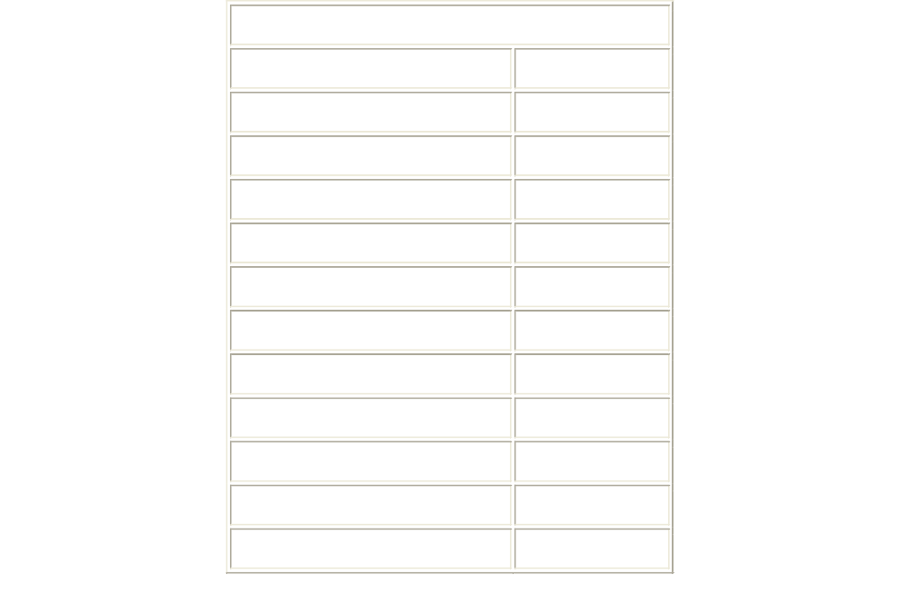
Techniques
Secure Deletion – Avoiding Recovery

Slide 19
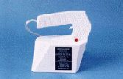
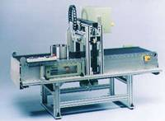
Commercial Degaussers
Type II/III
Type I

Slide 20
Deletion Techniques
Technique 2: Multiple Overwrites
Use an overwrite scheme
  Flip each magnetic domain on the disk back and forth as much as possible
  Overwrite in alternating patterns to expose it to an oscillating magnetic field.
  Overwrite with “junk” data several times
Use the lowest frequency possible for overwrites
  Penetrates deeper into the recording medium

Slide 21
Deletion Techniques
Peter Guttman’s overwrite scheme:
  Meant to defeat all possible recovery techniques (MFM, etc)
  Specifies 35 different overwrites
  Not all overwrites are needed if targeting specific recovery method (i.e. MFM)

Slide 22


Slide 23
Deletion Techniques
Extremely Extreme Physical Destruction
  Chainsaws
  Sledge hammers
  Drop in a volcano
  Place on apex of a nuclear warhead
  Multiple rounds from a high caliber firearm
Hard Drivers are tougher than you think

Slide 24
What can you do?
To reliably remove files?
Not Much - absolutely secure is very difficult given methods out today
Make it impractical or extremely expensive to recover

Slide 25
In the News
After buying 158 drives, ZDNet Finds:
  Over 5,000 credit card numbers
  Medical records
  Detailed personal and corporate financial information
  Personal Emails
  Gigs of pornography
Pennsylvania sold used computer that contained information about state employees
A woman in Nevada bought a used computer which contained the prescription records of over 2,000 customers of an Arizona pharmacy.

Slide 26

QUESTIONS?

Slide 27
Resources
http://www.geocities.com/spezzin_grazer/cap-4/cap4.htm
http://www.cs.auckland.ac.nz/~pgut001/pubs/secure_del.html
http://sfgate.com
http://www.executivesoftware.com
http://www.softwareshelf.com
http://www.geek.com/news/
http://www.slashdot.com
http://www.seminarsTopics.com

